Slide 1
‘The Integrated Model for Supervision’ Research Webinar February 15, 2024
Presented by: Chad Zemp & Salam Jabbour
PIs: Drs. Frédérique Vallières & Meg Ryan
Notes:
Welcome people
Thanks for joining
Introductions
Hope you enjoy – leave any questions for the end

Slide 2
Outline
Development and Progression of the IMS
Current IMS Research
Practical Implications
Future Directions
Notes:
This still leaves areas of interest that should be explored in the future such as …..

Slide 3
Development and Progression of the IMS
2019–2020
Phase 1
2020–2021
Phase 2
2021–2023
Phase 3
2023–2025
Phase 4
Participatory Action Research
Phase 1
Development
Phase 2
Piloting and Updating
Phase 3
Piloting and Research
Phase 4
Adaptation, Scale-up, M&E, ToTs
Notes:
2019 – Present
PAR - The development of the IMS has occurred following the ethos of participatory action research, which emphasis the equitable involvement of the research participants at each stage of the research process. PAR aims to enable action on collected data through a cyclical process of planning, acting, observing, and reflecting. These cycles have informed each stage of the IMS’s development and were chosen to maximise the impact and sustainability of the IMS as they reflect the needs and knowledge of the community that it is created to serve.
Phase 1 – Development – desk review, key informant interviews, systematic review, regional workshops, delphi study
Phase 2- Piloting with two training cohorts (Nigeria/Jordan and Afghanistan/Ukraine) - IMS and training was updated based on their feedback (which we will briefly explore a bit later on)
Phase 3 – Research outputs drawing from data collected during Phase 2 and Phase 3 – continued piloting of the IMS/training with two new organizations – Bangladesh and Ethiopia (Research outputs are informed by the participants from each of these IMS training cohorots)
Phase 4 – As Nick mentioned, phase 4 has the following principle deliverables refer to the slide

Slide 4
Current IMS Research https://supervision-mhpss.org/research/publications/
The acceptability, appropriateness, and feasibility of implementing supportive supervision within humanitarian contexts: A qualitative study (Ryan et al., 2023)
Gender considerations for supportive supervision in humanitarian contexts: a qualitative study (O'Sullivan et al., 2023)
Workforce Considerations for the IMS (in progress, 2024)
Implementing the ‘Integrated Model for Supervision’ within humanitarian contexts: A mixed-methods evaluation across five humanitarian organisations (in progress; 2024)
Notes:
Currently two published research outputs, 2 are currently being written (analysis has been done) - we will touch on the results of each of these and then talk about the practical implications that they have

Slide 5
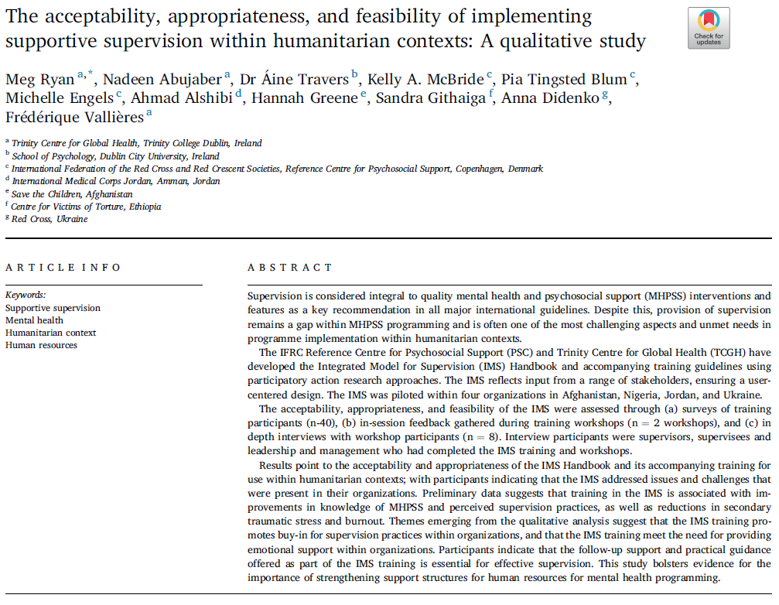
The acceptability, appropriateness, and feasibility of the IMS (Ryan et al., 2023)
Study Aims:
To better understand the cultural, contextual, and organisational appropriateness and acceptability of the IMS and its training
To ascertain the feasibility of implementing the IMS within geographically diverse humanitarian organisations
Methods:
Quantitative
n=98*
7 outcomes
3 timepoints
Qualitative
- Key informant interviews (n=8)
- Pilot feedback
Analysis:
Quantitative: timepoint comparison (one-way repeated measures ANOVA)
Qualitative: thematic analysis (deductive and inductive)
Notes:
Study aims:
Participants involved in quant methodologies came from 3 separate IMS training cohorts (2 in 2021 and 1 – 1 or 2 participants from Ethiopia and Bang joined the online - in 2022), representing 6 different organisations. Mention how Nigeria dropped out after the training – so no 1 month data
Quantitative: Data was gathered across 3 timepoints (pre-post-1mo followup), participants completed a questionnaire that measured 7 different outcomes (burnout, STS, perceived supervision, general self-efficacy, wellbeing, supervision confidence and knowledge). While there were 98 total participants across the 3 training cohorts, only 27% completed the quant survey at all 3 timepoints.
Qualitative:
Gathered through key informant interviews with IMS training participants from the 3 different cohorts. Interviews occurred 1 month post IMS-training. 23 participants agreed to participate, but only 8 ended up actually participating (with representation from all 3 organizational cohorts – LM, supervisor, supervisee Interviewees came from all participating orgs with the exception of UNICEF Nigeria, which had dropped out of the project by this time. Interview questions focused on the
Interviews were done using open-ended, non-directive questions. 3 main areas of inquiry which related to the study's aims: (1) what organisational conditions for supervision were present prior to the implementation of the IMS and what conditions may be required for its implementation, (2) an evaluation of the perceived impact of the IMS training materials, training workshop, and the provided follow-up support within each pilot org, and (3), identification of barriers and facilitators to the implementation of the IMS across the different orgs.
Pilot feedback was also gathered during the IMS Training to better understand areas of strength and weakeness specifically regarding the participants experience with the training, maintaing the PAR paradigm that drives the evolution of the IMS (not sure how many people completed this feedback).

Slide 6
Acceptability of the IMS (Ryan et al., 2023) - Quantitative Results
Decreases in:
STS
Burnout
General self-efficacy
Increases in:
Knowledge
Confidence
Perceived supervision
No statistically significant differences found (low sample size/loss to follow-up)
However, results indicate positive trends....
Notes:
Quantitative:
Decreases in STS and burnout scores between all timepoints
Increases in knowledge and confidence scores between all timepoints, perceived supervision decreased at post, but increased at 1 month follow-up
Because of the low sample size and loss of participants between the different timepoints, none of the score differences that were found among the outcomes were statistically significant (explain what this means?) hard to draw conclusions from it, but it suggets positive trends

Slide 7
Acceptability of the IMS (Ryan et al., 2023) - Qualitative Results
Low awareness of supportive supervision -> low resource prioritisation
Potential to impact staff turnover
Positive evaluation of the IMS
Facilitates creation or updating of supervision system
Adaptable to different contexts
Meets the need for emotional support
Practical element is appreciated/necessary
"We have a lot of people who came and after short times, they are going out so it is an indicator that something is going in the wrong way, and it might be from our side." (Supervisee, Jordan)
"Staff...are reporting that now...they are more comfortable to expressing feelings, to expressing emotions...because we took the IMS training and focused on....the emotional support" (Supervisor, Jordan)
"The process is very communicable, very useful for us...sometimes when I work with supervisees, they seek very specific things, very solid, very direct things" (Supervisor, Bangladesh)
Notes:
Awareness is important
Prior to the IMS training, some participants shared that there was a minimal awareness/common understanding of what supportive supervision is and why it is important. The mentioned how this gap in understanding was responsible for organizations under prioritizing resources for the provision of supervision (including time), and where supervision did occur, it was often irregular, inconsistent, and informal. On the other hand, participants form Jordan and Ethiopia mentioned how they had had positive experiences with supervision prior to the IMS training, which they attributed to an existing awareness within their orgs of the importance of supportive supervision (particularly for MHPSS work). This increased awareness could also lead to more protected time being alloted to regular supervision, which participants viewed as necessary
Staff turnover was also suggested to be helped with supportive supervision, as illustrated by green quote. Another participant remarked in order to create a stable professional system, it is very important to have a system like the IMS
The need for supervision to provide emotional support and develop skills was also mentioned, which we will return to in a bit
Positive reception to IMS
Facilities creation or updating – participants remarking being really interested in learning more about supervision and the IMS and referenced the utility of the structure for supervision that it provides (tools, protocols, etc.) and how it serves as a validating resources for orgs that are already doing sueprvision rpactices that are in line with it
As just mentioned, participants remarked on how supervision needed to provide emotional support to practicioners because of their direct interactions with beneficiaries and what they are exposed to. Its encouraging that participants reported that they believed the IMS achieved this need, as illustrated by this quote: point to blue quote
The practical element of the IMS was also very appreciated (case studies, example sesssion outlines, supervisory agreement, etc.) (red quote)
However, participants mentioned that there was a need for more guidance on how to deal with challenging situations (superivsee crying, confientidality being broken, etc.) bring in phase 4 bit on difficult emotions?

Slide 8
Acceptability of the IMS (Ryan et al., 2023) - Quanlitative Results cont.
Implementation largely depends on leadership/management (LM)
Slow process without their buy-in
Buy-in will require advocacy efforts, including M&E
LM need to openly and collaboratively communicate with supervisors and supervisees about the goals of implementation
Feedback on IMS training
Online training challenging, but engaging and constructive nonetheless
Training should be culturally adapted
Smaller IMS handbook would facilitate its use (including independent translations)
"For me, [the importance of the IMS] is clear, but to the managers it looks like it is just my opinion....we need to show some numbers, some quality and quantity indicators" (Supervisor, Ukraine)
"There needs to be a relationship between leadership/management, supervisor, and supervisee. Every employee needs to understand...the organization's vision, mission and goals..." (Supervisor, Jordan)
"that [supervision] plan came [the supervisees'] needs....they feel they they are belonging to this procedure, they are not just someone from the outside..." (Supervisor, Jordan)
Notes:
Implementation largely depends on LM
Their buy-in is essential to ensure that resources are allocated to supervision (as previously explored)
This buy-in can be increased by advocacy efforts (both within the training – adjusting the LM content to be more of 'making a case' for sueprvision) and through M&E efforts that can provide qualitative and quantitative indicators on the impact of supervision – this is also important for donors to secure more funding (refer to green quote)
Implementation will also need LM to communicate with supervisors and supervisees (blue quote), particurarly making sure that supervisees are part of the design and implementation process in order to ensure that supervision captures their needs (red quote)
Training Feedback
Participants found the online training challenging at times, mainly due to connectivity issues and would have preferred if it was in person. Nonetheless, they found it engaging and constructive, particularly highlighting the skill and knowledge of the IMS trainers/facilitators as facilitating learning. One participant commented on the need to culturally adapt the training, which agrees with the idea that the Handbook should be culturally adapted as well (mention cultural adaptation for Phase 4?). Finally, multiple participants suggested that the IMS could be smaller, with some suggesting that it be separated into two sections (theoretical guide and practical guide).

Slide 9
Implementing the ‘Integrated Model for Supervision’ within humanitarian contexts (in progress; 2024)
Study aims:
To assess for any changes in quantitative outcomes over time among those who participated in the IMS training
To better understand how the IMS was implemented across participating organisations following training
To generate recommendations on how the IMS handbook and training could be improved
Methods:
Quantitative
Baseline (n=59)
6month (n = 25)
12month (n=7)
Qualitative
Key informant interviews (n=15) (6 and 12 month)
Analysis
Quantitative: timepoint comparison (Skillings-Mack test)
Qualitative: thematic Analysis (deductive and inductive)
Notes:
This paper builds on the previous paper by employing largely the same methodology to achieve largely the same aims, which are -------
Methods:
These objectives were achieved through using a mixed methodology (using both quantitative and qualitative methods of analysis). Participants involved in quant analysis came from 3 separate IMS training cohorts (2 in 2021 and 1 in 2022, 2 in 2023), representing 6 different organisations.
Quantitative: Data was gathered across 3 timepoints (pre-post-1mo followup, 6mo, 12mo), participants completed a questionnaire that measured 7 different outcomes (burnout, STS, perceived supervision, general self-efficacy, turnover intention different from previous paper, supervision confidence and knowledge). So, for the baseline, post, and 1mo timepoints, there is some data overlap between this paper and the previous one from the training participants that were involved in that paper. However, this paper also adds data collection from those participants at the 6 and 12mo follow-up, as well as baseline, post, 1mo, 6mo and 12mo from participants from the two new trainings (Bangaldesh and Ethiopia).
Qualitative: Gathered through key informant interviews with IMS training participants at the 6month and 12month follow-up time points (instead of 1month as in previous paper – so largely the same participants from previous paper, just further in the implementation process). 10 participants took part in 6month and 5 in 12month (with some overlap). Aligned to the current study’s objectives, interview questions focused on the implementation of the IMS following training and to elicit further feedback on the IMS Handbook. using open-ended, non-directive questions.
Analysis
Quant – Skillings-Mack test – allows for between timegroups comparisons – does a good job at working around missing data (which there was a lot of – baseline to 6/12mo). We decided to leave out the 12month data because of how little there was and how that could lead to any reported results being misleading
Thematic analysis (deductive and inductive) - expand on what thematic analysis is. Deductive approach means that participants responses were coded and themed in line with the 3 areas of concern/interview questions. Inductive means that open-coding was also conducted, capturing any themes that may be different from the 3 areas of concern.

Slide 10
Implementing the IMS within humanitarian contexts (in progress; 2024) - Quantitative Results
Quantitative:
Significant decreases in:
Burnout
STS
Significant increases in:
Knowledge
Confidence
General self-efficacy
Notes:
Quantitative results tells us for which outcomes that were overall significant differences. We can do pairwise comparisons for each outcome to see where that difference lies (ie between which timepoints?):
Burnout (pre-6month, post-6month)
GSE (pre-post)
STS (results didn’t return answer)
Knowledge (pre-post, pre-6month)
Confidence (pre-post, pre-1month, post-1month)
No differences were found for PSS or TIS. These results build on those of the previous paper, by finding similar trends, but this time statistically significant. Interesting differences were increase vs decrease in GSE and increase in PSS in previous paper but not here.

Slide 11
Implementing the IMS within humanitarian contexts (in progress; 2024) - Qualitative Results
Implementation of IMS needs to be:
Driven by a 'gaps analysis'
Gradual
Collaborative
Flexible
Barriers to implementation
Need for systemic change
Impact of the IMS
Improved well-being
Decreased staff turnover
Enhanced team dynamics (collaboration)
Improved quality of work
Sustainability measures
"I already have used the Handbook and extracted quotes for proposals and things even in terms of advocating for staff to be like ‘the global standard says’, so I think that in itself has been really helpful just having that information when people are like what does this supervision even mean how is it different to what we are doing, to extract from the IMS" (Management, Afghanistan, 6 months)
"They [management] are in agreement with the supervision system, with the IMS. They are very appreciative of any suggestion, they are willing to hear on how to develop the system. It took time but it is happening. I can see the changes, I can see the spaces that they are making for us" (Management, Jordan, 6 months)
"We do believe that the IMS is a low-cost implementation model that has improved quality of services and sustainability" (Management, Jordan, 6 months)"
Notes:
Qualitative:
Implementation needs to be done based on a gaps analysis – what gaps do supervisors/ees see and how would they like them to be addressed (again touching on the importance of involving supervisees from previous paper). Supervision system can be designed/updated around this – with participants seeing the IMS as a useful template to do so, referring to it as the 'global standard’ (refer to green quote). Example of Ethiopia implementing peer supervision as a new modality and utilising new tools to measure impact (building on the system they already had)
Implementation of IMS needs to be gradual, collaborative, and flexible (i.e. imbedding supervision trainings into other trainings) based on the context (all of which echo findings from the previous paper).
Barriers that were identified to its implementation were: insufficient/inconsistent resources (both financially and not enough time – a result of heavy workloads – for implementation and training)
Limited understanding of supervision (both among management and staff)
To overcome these barriers, participants highlighted the need for continuing to enhance organisational knowledge on supervision (more trainings, discussion with other implementing orgs – Community of Practice), which will coalesence into an organisational shift towards recognising its importance (more resource allocation – again reminiscent of the previous paper) refer to blue quote
Impact of IMS
Improved staff well-being (lower levels of stress), more emotional support (reminiscent of previous paper)
Decreased staff turnover as a consequence of improved job satisfaction (also consistent with previous paper)
Enhancing team dynamics, which dovetails nicely with the need for collaboration in the implementation of the IMS
Improved quality of work (red)
To have sustained implementation, participants higlighted the need for follow-up trainings and support, excited by the ideas of ToTs as way to make this more internally sustainable. Participants also mentioned the need for conducting supervision M&E and guidance on how to do so – feeds into the development of the M&E compendium and updating

Slide 12
Gender Considerations in the IMS (O’Sullivan et al, 2023)
Study Aims:
- to identify key gender considerations for supportive supervision within MHPSS
- to ascertain how gender considerations should be incorporated into the IMS Handbook and
accompanying training guides.
Methods:
- Qualitative study
- Key informant interviews (N=12; n=8 women, n=4 men)
- September 2020-September 2022
Analysis:
- Thematic Analysis

Slide 13
Gender Considerations in the IMS (O’Sullivan et al, 2023) - Results
Results:
- Context matters (includes aspects related to culture, religion, and gender roles/expectations):
Some women had to step down from supervisory roles because of caretaking duties
- Recruitment: Less supervisory (“leadership”) roles afforded to women within MHPSS despite constituting the majority of the task force
- Within supervisory relationships:
Discussions around safety of women supervisees was more common
Supervisors incorporated reflective practices related to gender
- Supervision Formats: gender preferences for pairing with supervisors and other supervisees

Slide 14
Workforce Considerations for the IMS (in progress; 2024)
Study Aim:
- to understand experiences of humanitarian volunteers within organisations that began to adopt and implement the IMS
Methods:
- Qualitative study
- Individual interviews (N=9 individuals from Bangladesh who participated in the IMS training)
- September 2023
Analysis:
- Thematic Analysis
Results:
- Unique challenges of volunteering that can be mitigated by supervision
Emotional difficulties at work, competing life and work demands, competitiveness among other volunteers
- Adapting supervision for volunteers
Increased focus on emotional support and motivation, more discussions around safety
Supervisors cited needing less frequent sessions than volunteers
- Organisational conditions for volunteer supervision.
Funding and reshuffling of funds to prioritise sustainable supportive supervision practices

Slide 15
Practical Implications
How does the research translate into actionable points for organisations incorporating the IMS?
There needs to be true buy-in from organisations, with people in leadership roles who recognize its importance so that it can be properly implemented (Ryan et al, 2023)
Leadership representation should be present in the IMS trainings (Ryan et al, 2023)
Implementation should be collaborative, with particular emphasis on involving supervisees in the process (Ryan et al; 2023)
Implementation can be informed by a 'gaps analysis' (Implementing the IMS, 2024). This could be particularly helpful given low resources (i.e., allows for supervision to focus on the areas of greatest need)
Similarly, implementation can be done gradually (doesn't have to be 'all or nothing'). Organisations can also look for ways to integrate supervision into already existing systems/structures (Implementing the IMS, 2024).
There is no implementation without a well-defined and robust M&E system (Ryan et al., 2023; Implementing the IMS, 2024)
Emotional support should be the primary consideration in supportive supervision for volunteers (Workforce considerations, 2024)
Addressing competitiveness as a group dynamic, especially among volunteers, might be useful adaptation to existing resources (Workforce considerations; 2024)
Discussions around safety are integral to supervision, especially within humanitarian settings (O’Sullivan et al, 2023; Workforce considerations, 2024)
Notes:
Needed buy-in from organisations, recognition from the leadership of the importance of supportive supervision (Megs paper)
Takeaway - Organisational understanding of supervision is necessary for effective implementation
Importance of systems thinking and organizational structure, its not just the work force that needs to support supportive supervision, leadership needs to be present at some level in the IMS trainings (Megs paper)

Slide 16
Future Research Directions
Continued 6-month and 12-month follow-up data collection and analysis
Process evaluation of the IMS's adaptation for use in different contexts
Notes:
Follow up data collection will continue involve the participating organisations in Ethiopia (12month follow-up) and Bangladesh (6 and 12month follow-up)
These will employ the same mixed methodology as has been done in the past to try and continue to build the quantitative evidence base for the IMS as well as continuing to gather implementation stories and feedback on how the IMS can be improved going forward in order to more effectively facilitate implementation across different contexts
We are also going to be conducting a process evaluation which will have the aim of capturing how the IMS undergoes its process of cultural adaptation (documenting and reflecting on each step) and any facilitators/challenges that were encountered towards achieving this adaptation – this research will add the the knowledge around how to adapt (and things you might want to plan for along the way) a guidebook such as the IMS for different context.
These are just focused on research (i.e. papers to be published) and do not include the piloting processes for the M&E resources (guidelines and TP) and cultural adaptation guidelines (updated) or newly translated/adapted Handbooks for each new region

Slide 17
Thank you!
Questions?
Find out more about the IMS at: https://supervision-mhpss.org/
Email: czemp@tcd.ie or jabbours@tcd.ie

